Slide 1
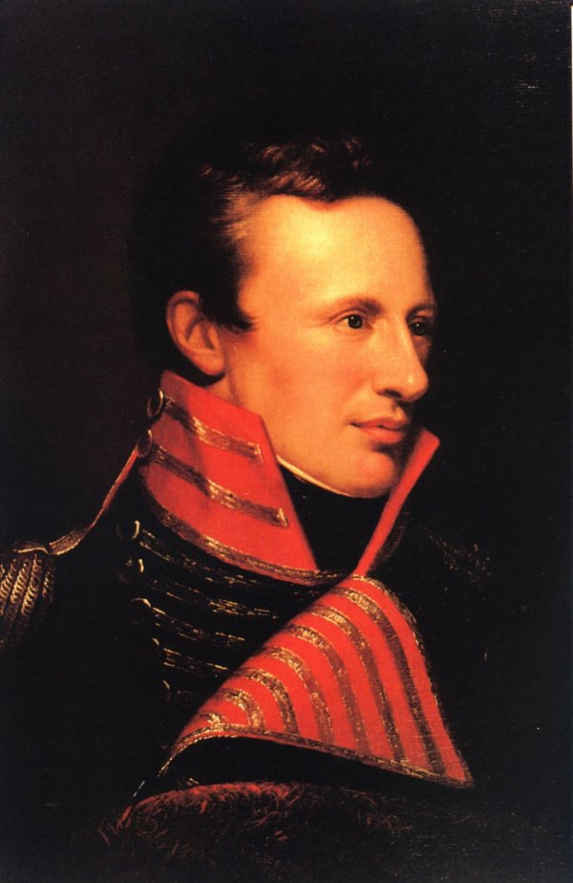
Zebulon Pike
By Steven Silbert

Slide 2
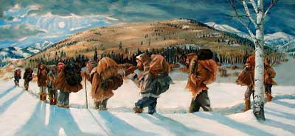
Introduction
Pike’s Journey through Kansas to Colorado
Capture by the Spanish
Being overshadowed by Lewis and Clark’s Expedition
Notes:
In this presentation I am going to cover a famous figure in American history who is partially responsible for opening up the Southern part of the Louisiana Purchase. Zebulon Pike led an expedition starting in 1806 out of St. Louis Missouri to find the Headwater of the Red River, but along the way was Captured by the Spanish after his party lost there way(. He is not very well known because around the same time, Lewis and Clark had just completed their epic journey.

Slide 3
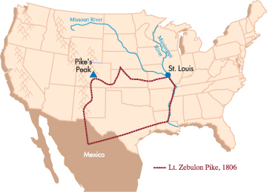
Journey to Pike’s Peak
Commissioned by Gen. James Wilkinson
Search for the Head of the Red River
Tried to reach the top of “Pike’s Peak”
Notes:
The journey was commissioned by General James Wilkinson who was appointed governor of the Louisiana territory by President Thomas Jefferson. Another one of his tasks was to find and make an alliance with the Pawnee Indian tribe which was at the time the largest tribe in the midwest. By the time he made contact with the Pawnee, they had just been visited by some 300 Spanish Cavaliers and they had a Spanish flag raised in their village. Pike convinced them to put up and American flag and side with the Americans. Pike is probably most well known for a mountain he has named after him in Colorado known as Pike’s Peak. His party attempted to climb and use the peak as a vantage point, but ended up in waist-high snow and had to abandon the trek.

Slide 4
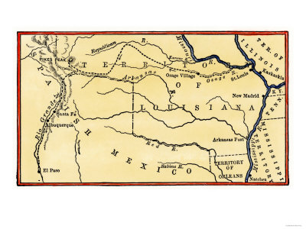
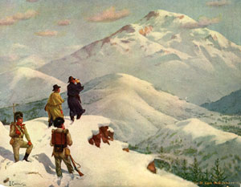
Spanish Capture
Captured in then Northern New Mexico
Thought to be a spy
Released July 1, 1807 into Louisiana
Notes:
Shortly after abandoning their attempt to clime Pike’s Peak the party was discovered while hunting by a Spanish Cavalry party in February 1807. Unwittingly they had passed into Spanish territory and their party was captured. He and his party were taken to Sante Fe and then to Chihuahua before being released back into the USA territory. There is some controversy today, especially within the Hispanic community, disparaging Pike for being a spy, but there is no evidence pointing one way or the other.

Slide 5
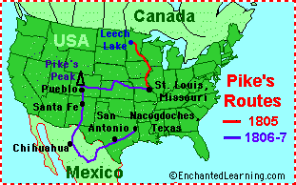
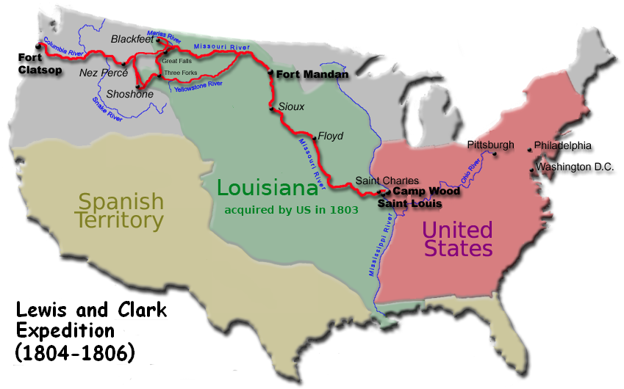
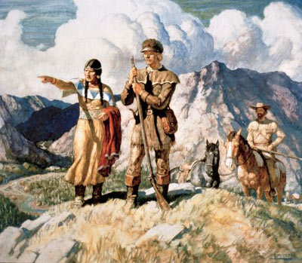
Lewis and Clark’s Shadow
Difference in Backgrounds
Substandard Journaling
Lewis and Clark used as Symbols
Notes:
There are a few reasons why Lewis and Clark are so much more popular today than Zebulon Pike. First of all, Lewis and Clark came from socially higher, better educated backgrounds which contributed to the quality of both their journals and maps. They were officially sent off by Thomas Jefferson, while Pike was sent off by Wilkinson. Another big reason for the success of Lewis and Clark over Pike, was what they stood for. The Sierra Club views them as pioneers of science, naturalists of their time, who set of into the pristine wilderness in search of new lands. Modern day feminists look to Sacagawea as a symbol as on of the “founding mother[s]” of this country. For these reasons, although Pike was responsible for great progress in the Louisiana Territory, his is little known today.

Slide 6
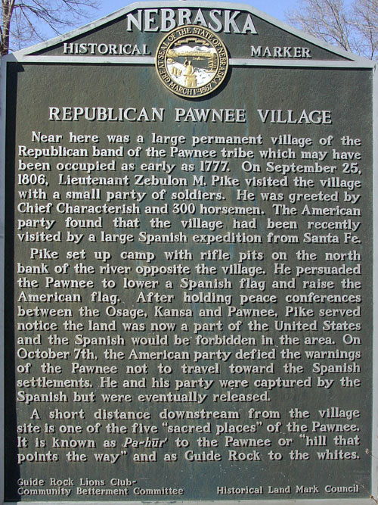
Conclusion
Notes:
In conclusion, Pike’s journey was important not just for exploring previously unexplored territory, but for also being “a key to opening the Santa Fe Trail.” After returning from Spanish territory, Pike earned great esteem in the war of 1812 where he was promoted to Brigadier General. And finally, “on April 27, 1813, he was killed while leading an attack on British forces in Canada during the war of 1812.” Pike lived an extraordinary life and deserves a bigger place in textbooks for paving the way into the American Southwest.

Slide 7
Bibliography
Interest is piqued in zebulon pike. (2006, Dec 03). The Salina Journal. Retrieved from http://search.proquest.com/docview/381166499?accountid=10355

