Slide 1
A Cross-Cultural Comparison of Perceptions of Male Attractiveness between the USA and Japan
Steven Bryan Silbert
Advisors:
Dr. Yoshiko Saito-Abbott
Dr. Chikaomi Takahashi

Slide 2
Outline
Significance of the study
Research Question
Research Background
Research Method
Research Findings
Conclusion
Bibliography
Acknowledgements

Slide 3
Significance of the Study
During my stay in Japan, I noticed that men dress and present themselves in very different ways than the men do in America.
I believe that these differences show a difference in the perceptions of attractiveness between each country.
I want to identify which factors, be they physical, mental or superficial like clothing and make-up, play the most important roles when looking for and attracting a potential mate in both countries and why.

Slide 4
Research Questions
What areas do men feel they need to improve in themselves the most when attracting a mate in Japan and America?
What are the areas in men that are most attractive to women who are looking for a mate in Japan and America?
How do men’s perceptions meet the woman’s perceptions, and how do each country’s perceptions match up against each other?

Slide 5
Background Research
The Science of Attraction
Physical- Face vs. Body
Evolutionary Theories
Self-Presentation in Japan vs. America
Are Japanese men more modest than their American counterparts?
Male Attractiveness in Japan
Nikushoku Danshi vs. Soushoku Danshi
Collectivist Culture and Japanese Men’s Beauty Care
Men in Magazines
Men in Advertisements
Boy Bands

Slide 6
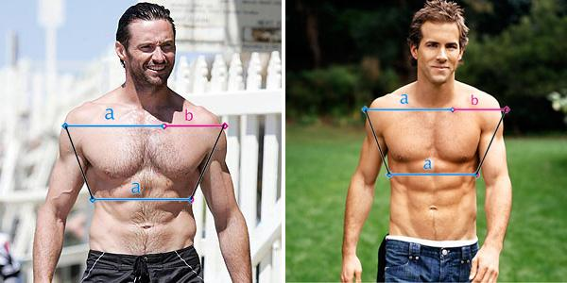
The Science of Attraction
The face is more important than the body in determining attractiveness (Currie, 2009).
Evolutionary Theories of Attraction (Gangestad, 2005).
A big shoulder to waist ratio is more attractive
Men with more money/higher social status can provide for children and therefore attractive

Slide 7
Self-Presentation in Japan vs. America
The general human trend to view oneself in a positive light is not universal (Yamagishi, 2012).
Japan | America
View themselves as interdependent which motivates them in relation to the needs of others | View themselves as independent which motivates them to act independently of others and see themselves in a positive light.
Japanese men tend to be modest in order to avoid insulting others. | American men tend to be self-enhancing during self-evaluations.

Slide 8
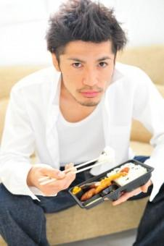
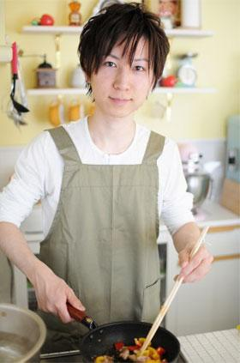
Male Attractiveness and Japan
Typical stereotypes of the attractive male include: Tall, muscular body, symmetrical face, big shoulders and small waist, confident personality, etc..
Many of these features would describe what is known as the “Nikushoku Kei” or carnivorous man in Japan.
A new phenomenon has emerged in Japan known as “Soushoku Kei” or the herbivorous man (Engelhart, 2009)
Term coined by writer Maki Fukasawa in 2007
Term describes the more “lady-like” men that have been growing in numbers recently
A recent study shows that 60% of Japanese men age 20-34 somewhat fall into this category
Nikushoku Kei
Soushoku Kei

Slide 9
A Comparison of Carnivores and Herbivores
Carnivores (Nikushoku Kei) | Herbivores (Soushoku Kei)
Dark Skin | Light Skin
Muscular | Thin
Light-Colored Hair | Dark Hair
Spikey, Upright Hair Style | Natural Hair Style
Sexually Active | Uninterested in Relationships or Sex
Strong and Competitive | Close to Mother
Wears Suits and Leather Clothing | Wears Tight-Fitting, Cloth Clothing

Slide 10
Collectivist Culture and Japanese Men’s Beauty Care
Japan is often described as a Collectivist Culture (Trandis)
Personal goals are often seen as less important than those of society
Japanese men in their 20s and 30s have been influenced by the term “ikemen” or “good-looking man"(Kyodo, 2012)
“If I look unkempt, it would be embarrassing for my friends when they hang out with me. I also want to make a good impression on my customers,” says 34-year-old Osaka patissier
Men using beauty care products is on the rise especially nail, skin and hair care
In a 2011 study, Japanese men in Tokyo spent an average of 11,000 yen or $110 on beauty care products.(Kyodo, 2012)

Slide 11
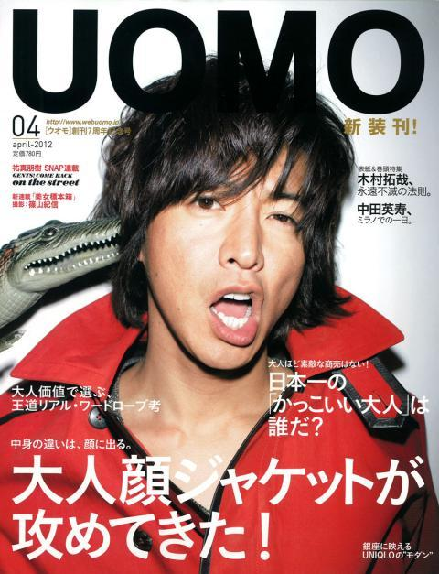
Men in the Media: Magazines
“Build arms like these!”
“Who is Japan’s ‘cool’ adult?”
America
Japan
Fitness-oriented most popular | Fashion-oriented most popular
Very muscular men depicted | Thinner, more realistic men depicted
Talk about how to be more “manly” | Talks about seasonal fashion trends (collective thought)

Slide 12
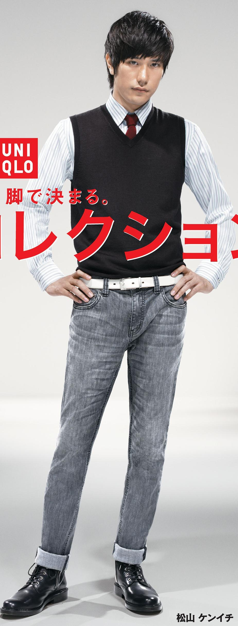
Men in the Media: Advertisements
America
Japan
Both thin and very muscular models | Mostly thinner models
Emphasizes Masculinity | Emphasizes looking “ikemen” or “pretty”
How to “stand out” of the crowd | How to “fit in” with the crowd

Slide 13
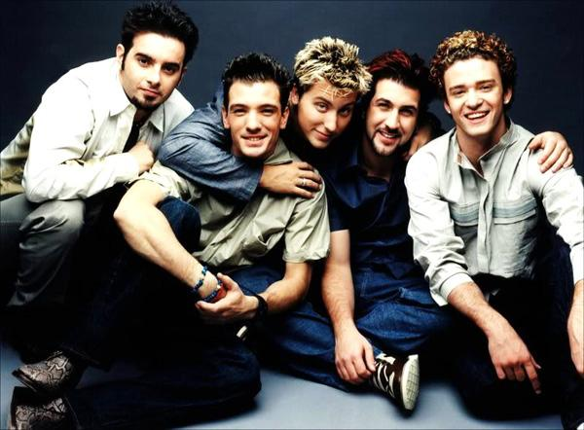
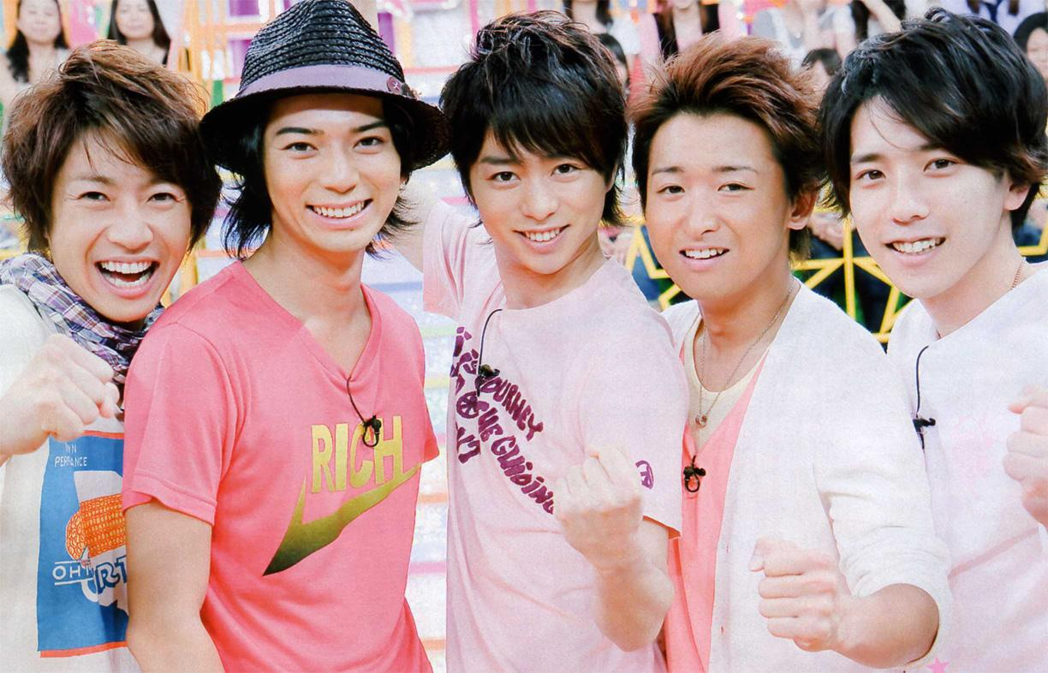
Men in the Media: Boy Bands
America
Japan
Popularity decreased after the 2000s | Popularity is on the rise
Reflects the more masculine fashion trends of America | Reflects the more pretty-boy trends in Japan
Boy bands’ popularity in japan and lack thereof in America reflects each society’s respective leaning towards conformity and non-conformity.

Slide 14
The Study
Research Questions
What areas do men feel they need to improve in themselves the most when attracting a mate in Japan and America?
What are the areas in men that are most attractive to women who are looking for a mate in Japan and America?
How do men’s perceptions meet the woman’s perceptions, and how do each country’s perceptions match up against each other?

Slide 15
Research Method
Study Participants
104 of University Students
50 of Japanese University Students
19 men and 31 women
54 of American University Students
20 men and 34 women
Research Instrument
Online Survey (Google Forms)
English Survey
Japanese Survey

Slide 16
Demographic Data

Slide 17
Demographic Data

Slide 18
Research Question 1
What areas do men feel they need to improve in themselves the most when attracting a mate in Japan and America?

Slide 19
How often do you exercise?
American men exercise much more than their Japanese counterparts.

Slide 20
If you exercise, what is the main reason?
Overall, American men and Japanese men have similar reasons for exercising
Japanese men exercise more than American men for enjoyment
American men exercise more to maintain or lose weight

Slide 21
Hair Care
American and Japanese men visit the salon with similar frequency
Japanese men tend to spend more money per haircut

Slide 22
Personal Hygiene
How much money do you spend per month on the following personal hygiene products?
American men spend more money on Fragrances and Shaving/Facial products
Japanese men spend more money on Hair care products

Slide 23
Clothing
Japanese men spend more money on clothing
More Japanese men frequently go clothes shopping.

Slide 24
Clothing Cont’d
Japanese men: shop more at small boutiques
American men: shop more at less expensive stores like thrift shops and large department stores
Japanese men: Price and Style most important
American men: Comfort and Style most important

Slide 25
How much you agree with the following statements in regard to being attractive to women?
American Men
Japanese Men

Slide 26
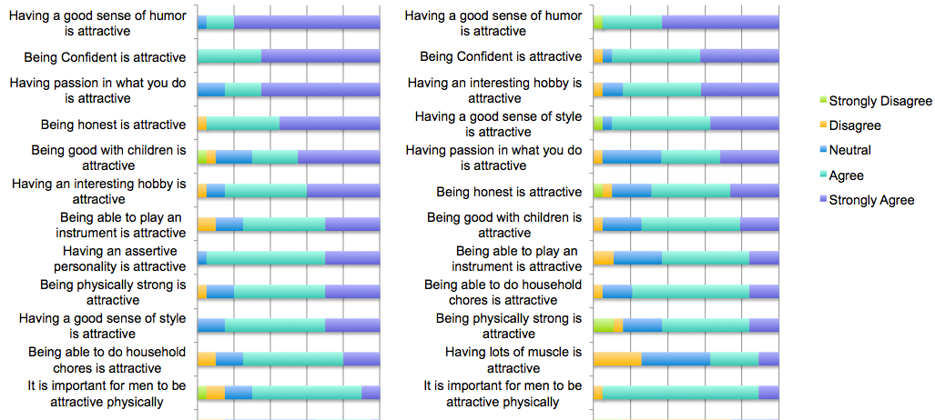
How much you agree with the following statements in regard to being attractive to women? Similarities
American Men
Japanese Men
Both American and Japanese men believe that:
Having a good sense of humor is attractive
Being confident is attractive
Being physically strong is attractive
It is important for men to be attractive physically

Slide 27
How much you agree with the following statements in regard to being attractive to women? Differences
American Men
Japanese Men
American men believe more than Japanese men that:
Being honest is attractive
Having an assertive personality is attractive
Having passion in what you do is attractive

Slide 28
Please rate the level of importance for each of the following Physical traits when attracting a potential mate
70%
On average, Japanese men feel, about 20% more than American Men, that being Powerful, Tall, Clear Skinned, and Muscular is important and very important when trying to attract a mate.

Slide 29
Please rate the level of importance for each of the following Lifestyle traits when attracting a potential mate
American and Japanese men both believe that having a Healthy Diet, Playing Sports, being able to Cook and do Household Chores are attractive to women.
Both are also in agreement that Playing a Musical Instrument and Wearing Cologne are not very important.
However, Japanese men view traits related to appearance, like Styled Hair and Stylish Clothing, as being more important than American men.

Slide 30
Please rate the level of importance for each of the following Personality traits when attracting a potential mate
Very Important
Very Important
Overall, both Japanese and Americans had a similar ranking order of results.
American men chose “very important” much more than Japanese men did.
Japanese men ranked Good Relationship with Family higher than American men did.
American men ranked Honest Higher than Japanese men did.

Slide 31
Please rate the level of importance for each of the following Background traits when attracting a potential mate
Both American and Japanese men agree that being Highly Educated is attractive to women
Japanese men put more emphasis on having a High Social Status and Income than American men
Being Religious isn’t seen by either culture’s men as being important in attracting women

Slide 32
Research Question 1: Findings
American men found Personality traits more important in determining male attractiveness than Japanese men did.
Japanese men found Physical, Lifestyle, and Background traits to be more important in determining male attractiveness than American men did.
Although American men found Physical traits to be less important than Japanese men did, they tend to go to exercise more often.
Japanese men tend to be more influenced by peers and family while American men are more influenced by the media.

Slide 33
Research Question 2
What are the areas in men that are most attractive to women who are looking for a mate in Japan and America?

Slide 34
Please rate how much you agree with the following statements in regard to being attractive to women
American Women
Japanese Women

Slide 35
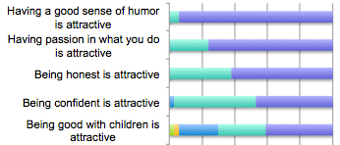
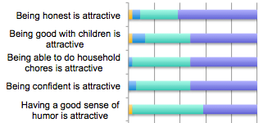
Please rate how much you agree with the following statements in regard to being attractive to women
American Women’s Top 5
Japanese Women’s Top 5
American Women:
Having a good sense of humor is most attractive
Having passion in what you do is more attractive to American women
Japanese Women:
Being honest is most attractive
Being good with children and being able to do household chores is more attractive to Japanese women.
Both cultures equally view confidence as attractive

Slide 36
Please rate how much you agree with the following statements in regard to being attractive to women
American Women’s Bottom 5
Japanese Women’s Bottom 5
American Women:
View having lots of muscle as least attractive
Having an assertive personality is viewed positively
Have a more neutral view of having a thin body
Japanese Women:
View having a thin body as least attractive
Having an assertive personality is viewed negatively
Have a more neutral view of having muscle

Slide 37
Please rate the level of importance for each of the following Physical traits when choosing a potential mate
American woman have a neutral or unimportant perception of physical traits
Japanese women clearly view being Tall, Powerful, Muscular, and Clear Skinned as being attractive
Both cultures see piercings and tattoos as unimportant

Slide 38
Please rate the level of importance for each of the following Lifestyle traits when choosing a potential mate
Both Culture’s women see Healthy Diet, Can Cook and Does Household Chores as important
Plays Sports, Stylish Clothing, and Styled hair are more important to Japanese women

Slide 39
Please rate the level of importance for each of the following Personality traits when choosing a potential mate
Both Culture’s women find personality to be very important in determining attractiveness of males
American women find having a Sense of Humor to be more important than Japanese women
Japanese women find having a Good Relationship with Family to be more important than American Women

Slide 40
Please rate the level of importance for each of the following Background traits when choosing a potential mate
Excepting being Highly Educated, background is unimportant in determining attractiveness for American women
Japanese women see one’s Income, Social Status, and Education backgrounds as being important

Slide 41
Research Question 2: Findings
American woman find Personality to be more important in a potential mate, while Japanese women find Physical, Lifestyle, and Socio/Economic background traits to be more important.
Japanese women want men to have good family skills, while American women want men to have strong individual personalities.

Slide 42
Research Question 3
How do men’s perceptions meet the woman’s perceptions, and how do each country’s perceptions match up against each other?

Slide 43
How do men’s perceptions meet the woman’s perceptions?
Traits | American Men | American Women
Physical | 1. Tall 2. Powerful 3. Clear Skin 4. Thin 5. Muscular | 1. Clear Skin 2. Tall 3. Thin 4. Facial Hair 5. Powerful
Lifestyle | 1. Healthy Diet 2. Plays Sports 3. Stylish Clothing 4. Can Cook 5. Does Household Chores | 1. Healthy Diet 2. Can Cook 3. Does Household Chores 4. Wears Cologne 5. Stylish Clothing
Personality | 1. Honest 2. Respectful 3. Faithful 4. Sense of Humor 5. Kind | 1. Respectful 2. Sense of Humor 3. Kind 4. Faithful 5. Honest
Background | 1. Highly Educated 2. High income 3. High Social Status 4. Is Religious | 1. Highly Educated 2. High Income 3. Is Religious 4. High Social Status

Slide 44
How do men’s perceptions meet the woman’s perceptions?
Traits | Japanese Men | Japanese Women
Physical | 1. Muscular 2. Clear Skin 3. Tall 4. Powerful 5. Facial Hair | 1. Tall 2. Powerful 3. Muscular 4. Clear Skin 5. Thin
Lifestyle | 1. Can Cook 2. Healthy Diet 3. Does Household Chores 4. Plays Sports 5. Stylish Clothing | 1. Healthy Diet 2. Can Cook 3. Does Household Chores 4. Plays Sports 5. Stylish Clothing
Personality | 1. Faithful 2. Kind 3. Respectful 4. Sense of Humor 5. Confident | 1. Faithful 2. Respectful 3. Kind 4. Honest 5. Good with Children
Background | 1. Highly Educated 2. High Social Status 3. High Income 4. Is Religious | 1. High Income 2. High Social Status 3. Highly Educated 4. Is Religious

Slide 45
Research Question 3: Findings
Greater differences in perception of attraction were found between countries rather than between sexes of the same culture.
American men and women tended to have a similar ranking of traits than their Japanese Counterparts; however, there was a great amount of variation within each sex.
Japanese men and women differed in perceptions of attraction more than their American counterparts; however, there was much less variation within each sex.

Slide 46
Conclusion/Discussion (opinion)
Although men are more often portrayed as being very muscular in American media than Japanese media, American women do not find muscularity to be as important as Japanese women do.
Overall, Japanese men and women believe physical appearance and socio/economic background to be more important in determining male attractiveness than their American counterparts, whereas American men and women believe personality to be most important.
Although Soushoku kei or “herbivore” men are increasing in Japan, Japanese women are more attracted to the masculine, Nikushokukei type men.

Slide 47
Limitations of the Study
This study cannot be generalized to the entire populations of Japan and America, rather this is a reflection of younger, university level people.
This study was limited to Japan and America, but it would be interesting to see more specific differences between prefectures and States.
This study only dealt with heterosexual perceptions.

Slide 48
Future Study
It would be interesting to split up the sample population into smaller geographical areas and see how the results differ between urban and rural areas.
It would also be interesting to see how the results differ when people are separated into categories of age, sexual orientation, and ethnicity and see how the res

Slide 49
Bibliography
Currie, T. , Little, A. (2009). The relative importance of the face and body in judgments of human physical attractiveness. Evolution and Human Behavior, 30(6), 409-416.
Engelhart, K. (2009). The grass-eating boys of Japan. Maclean's, 122(25), 34.
Gangestad, S. , & Scheyd, G. (2005). The evolution of human physical attractiveness. Annual Review of Anthropology, 34, 523-548.
Otake, T. (2009). Blurring the boundaries: As the future facing japan's young people changes fast, so too are traditional gender identities. McClatchy - Tribune Business News, .
Toro-Morn, M. , & Sprecher, S. (2003). A cross-cultural comparison of mate preferences among university students; the united states vs. the people's republic of china (prc). Journal of Comparative Family Studies, 34(2), 151-170.
Triandis, H. C., Bontempo, R., Villareal, M. J., Asai, M., & Lucca, N. (1988). Individualism and collectivism: Cross-cultural perspectives on self-ingroup relationships. Journal Of Personality And Social Psychology, 54(2), 323-338.
Yamagishi, T. , Hashimoto, H. , Cook, K. , Kiyonari, T. , Shinada, M. , et al. (2012). Modesty in self‐presentation: A comparison between the usa and japan. Asian Journal of Social Psychology, 15(1), 60-68.
Kyodo. (2012, June 19). Young Japanese men’s trend: Trying to look pretty. Retrieved from
http://www.japantimes.co.jp/news/2012/06/19/national/young-japanese-mens-trend-trying-to-look-pretty/#.U1fbOse9g30

Slide 50
Acknowledgements
Dr. Yoshiko Saito-Abbot, Dr. Chikaomi Takahashi, Michiko Terajima, Kaya Iwasaki, fellow Japanese majors, Friends, Family, and coffee… lots of coffee…

